Slide 1
Network of Postdoctoral Training Programs in Psychology Michigan Medicine / VA Ann Arbor
Clinical Child Psychology
Clinical Neuropsychology Consortium
Clinical Psychology Consortium
SMITREC VA Fellowship Program

Slide 2
Rachel Upjohn Building
MICHMED Clinical Adult

Slide 3
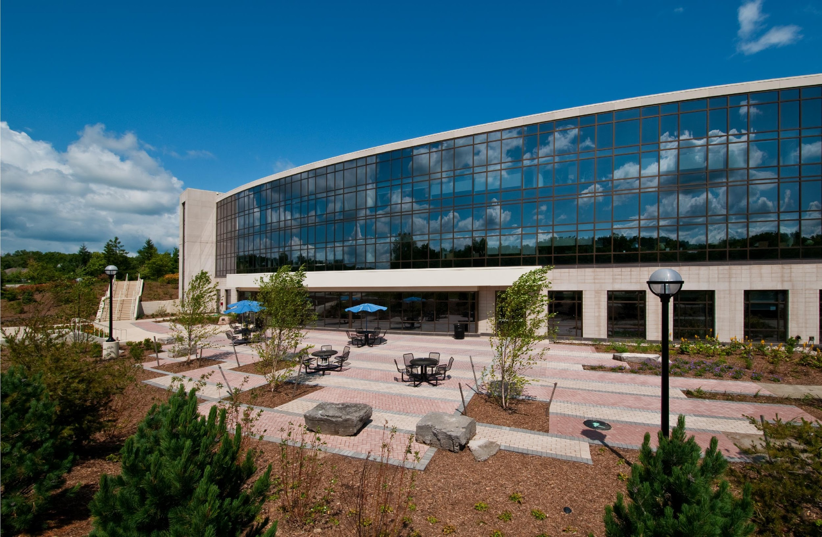

Slide 5
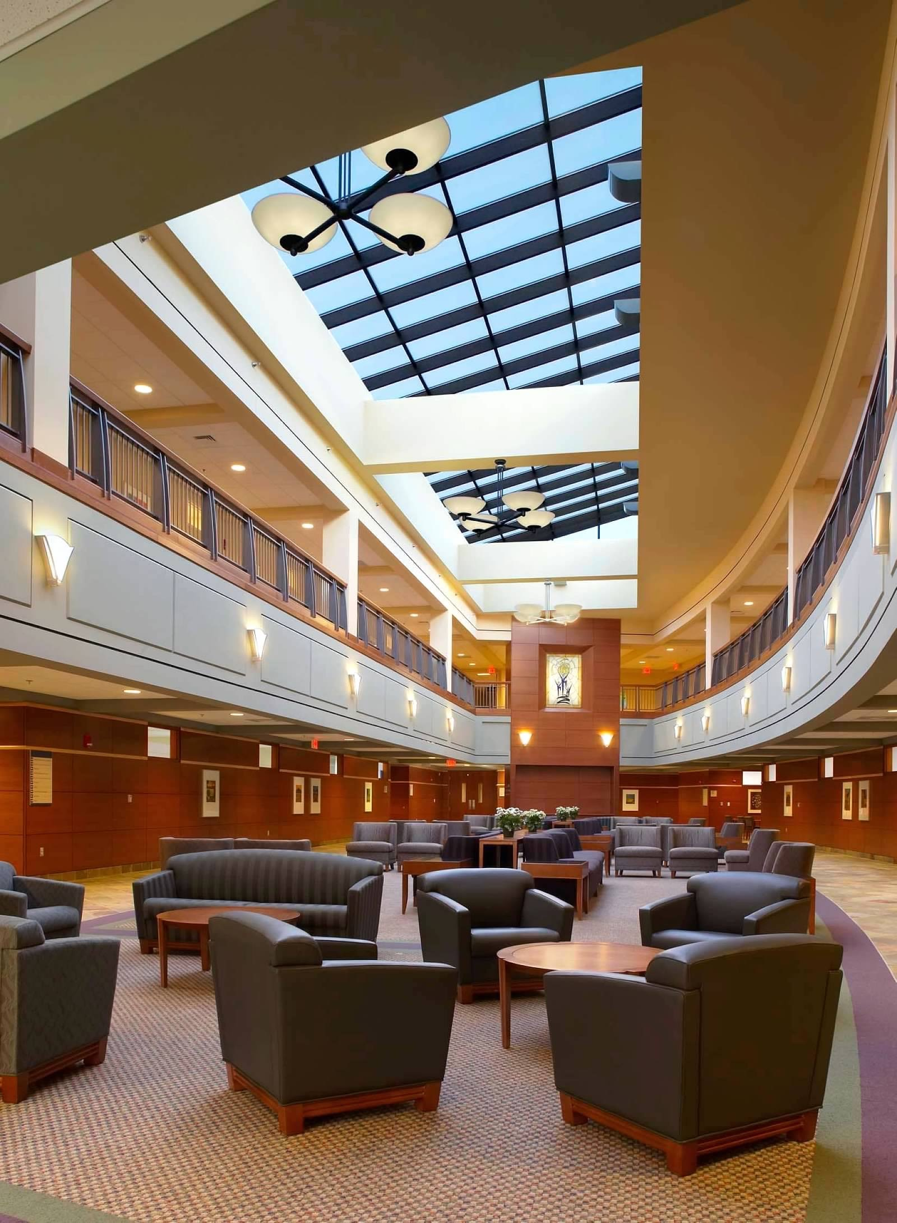

Slide 7
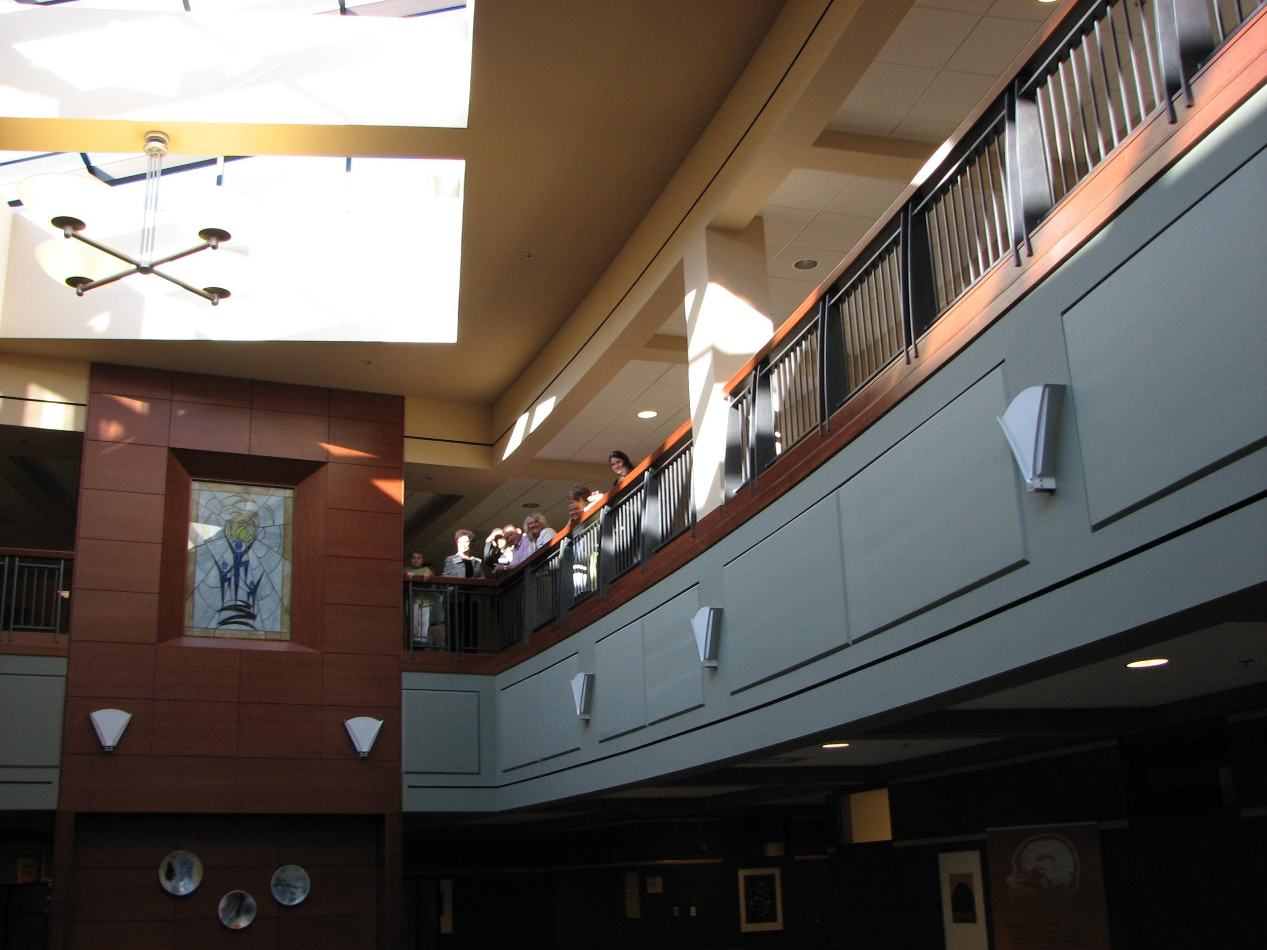

Slide 8
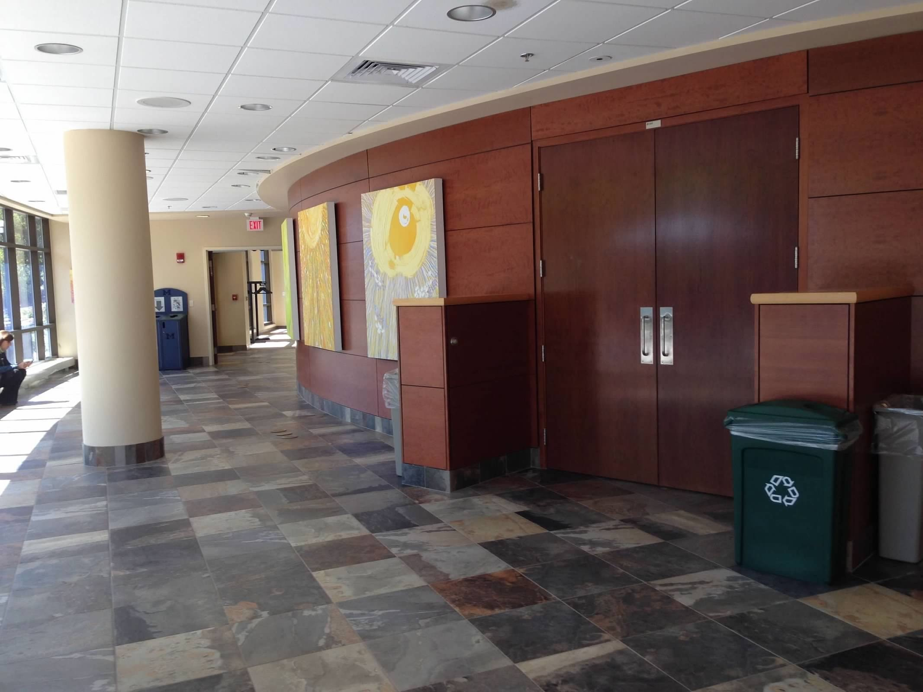

Slide 9
VA Ann Arbor Medical Center
VA Clinical Adult

Slide 10
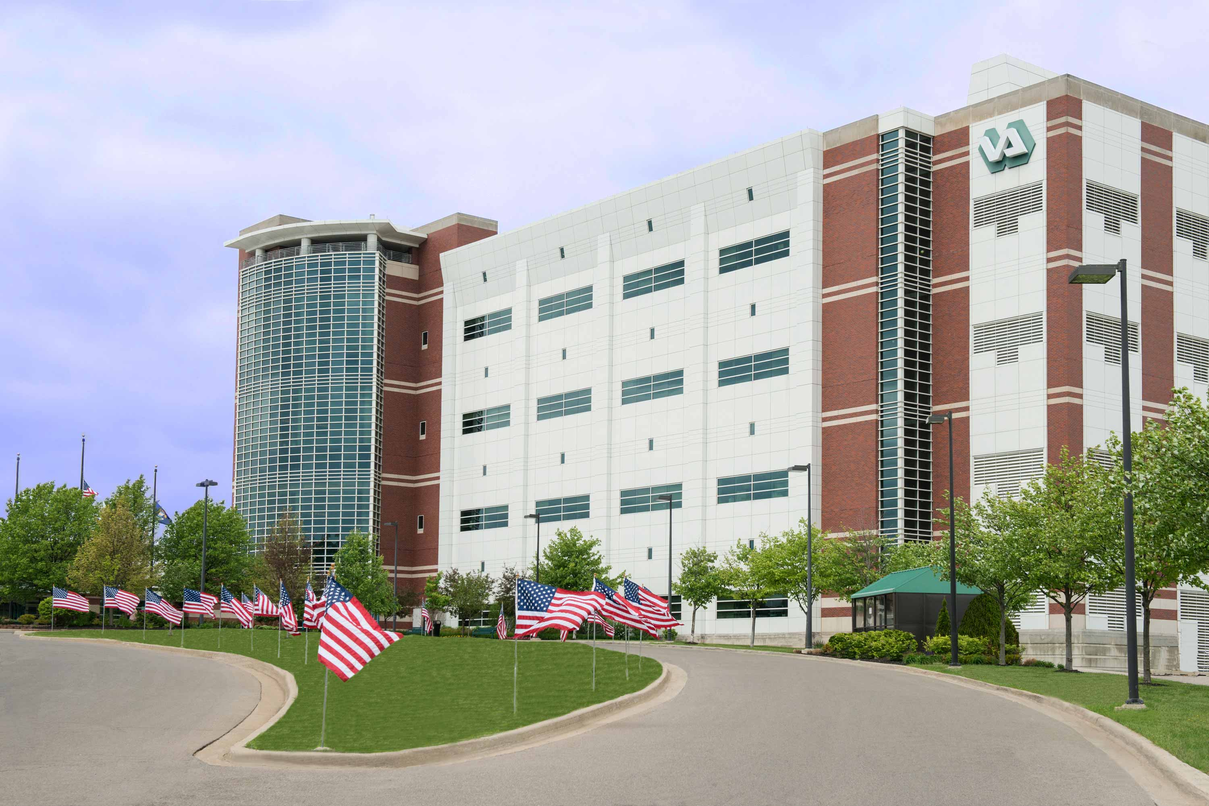

Slide 11
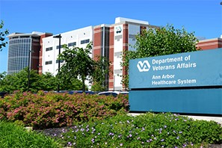

Slide 12
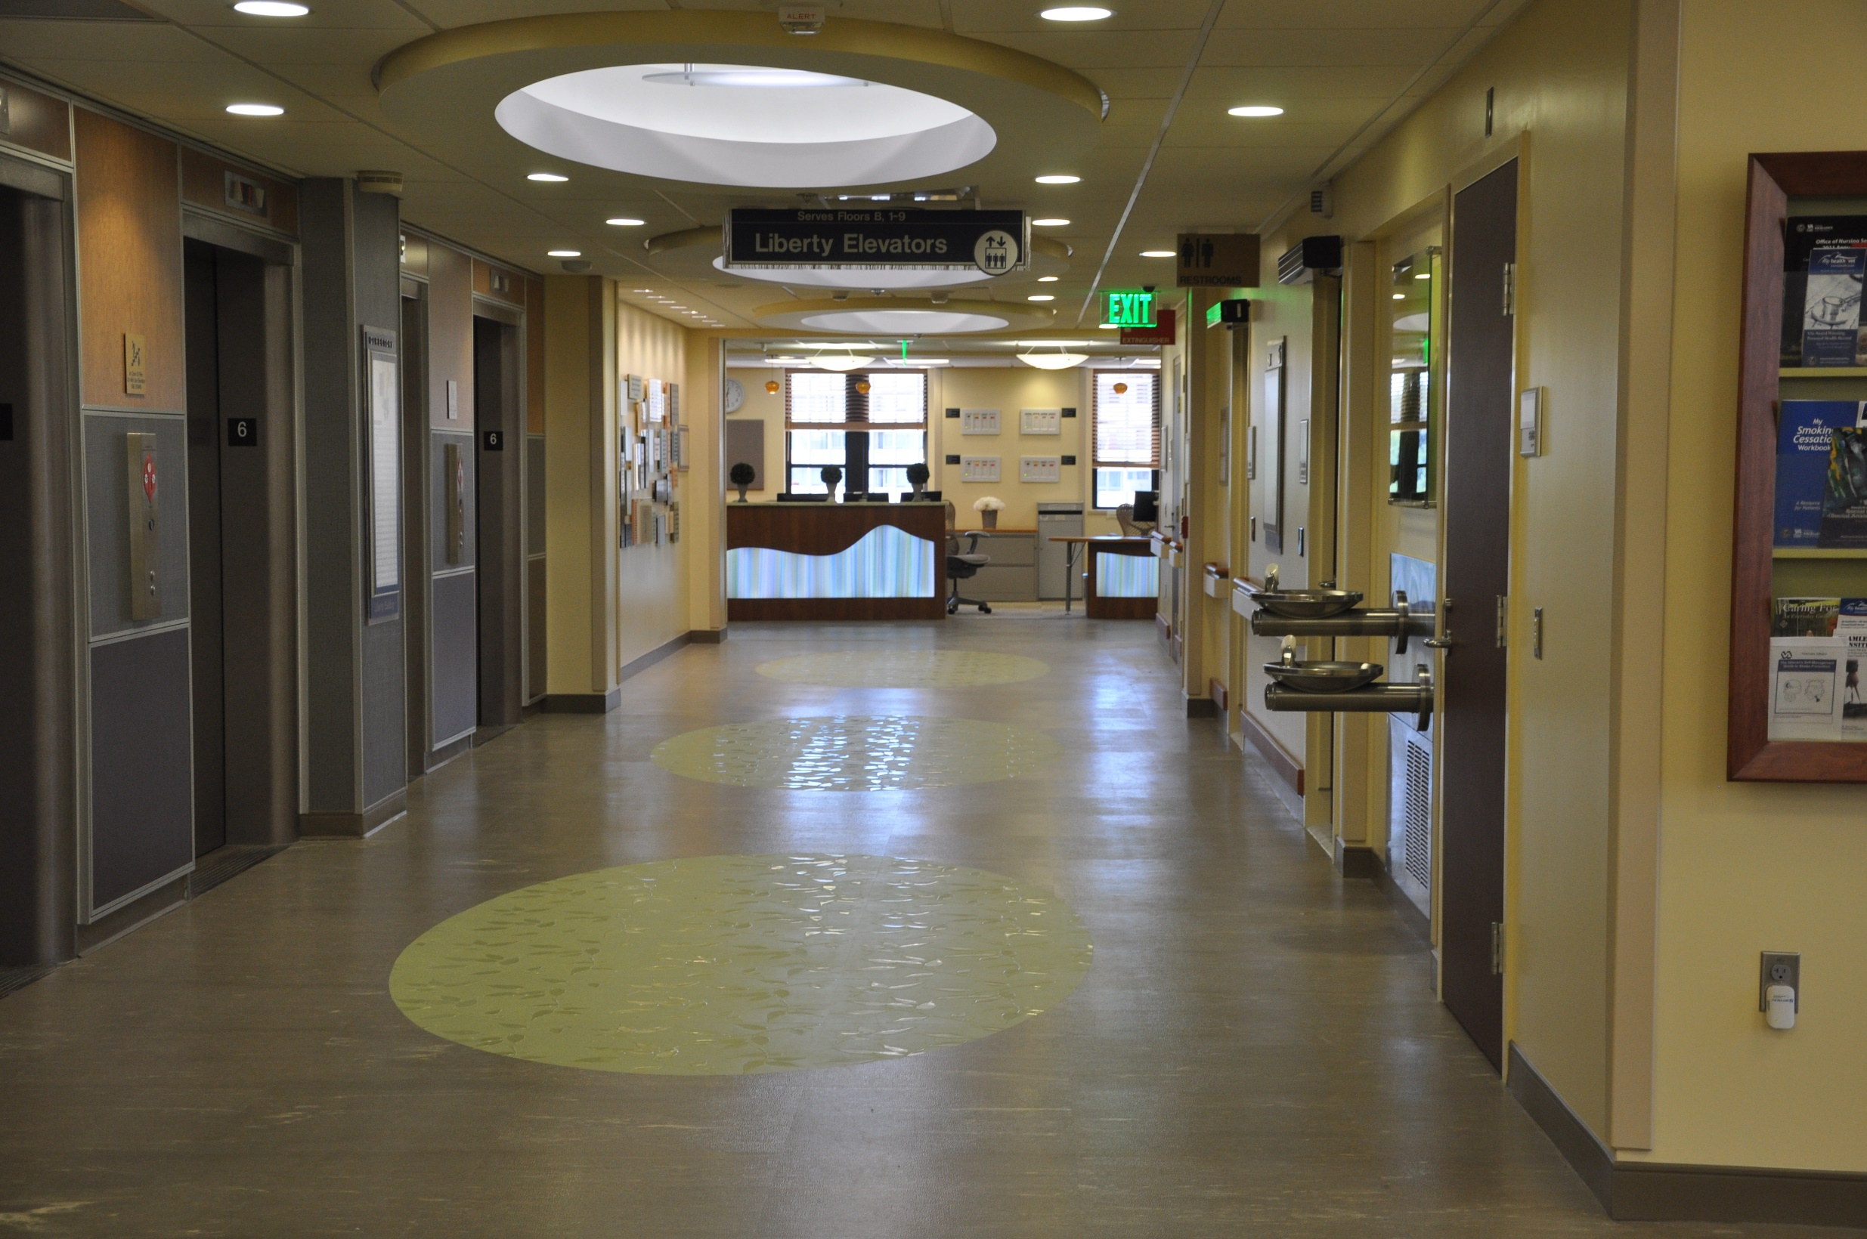

Slide 13
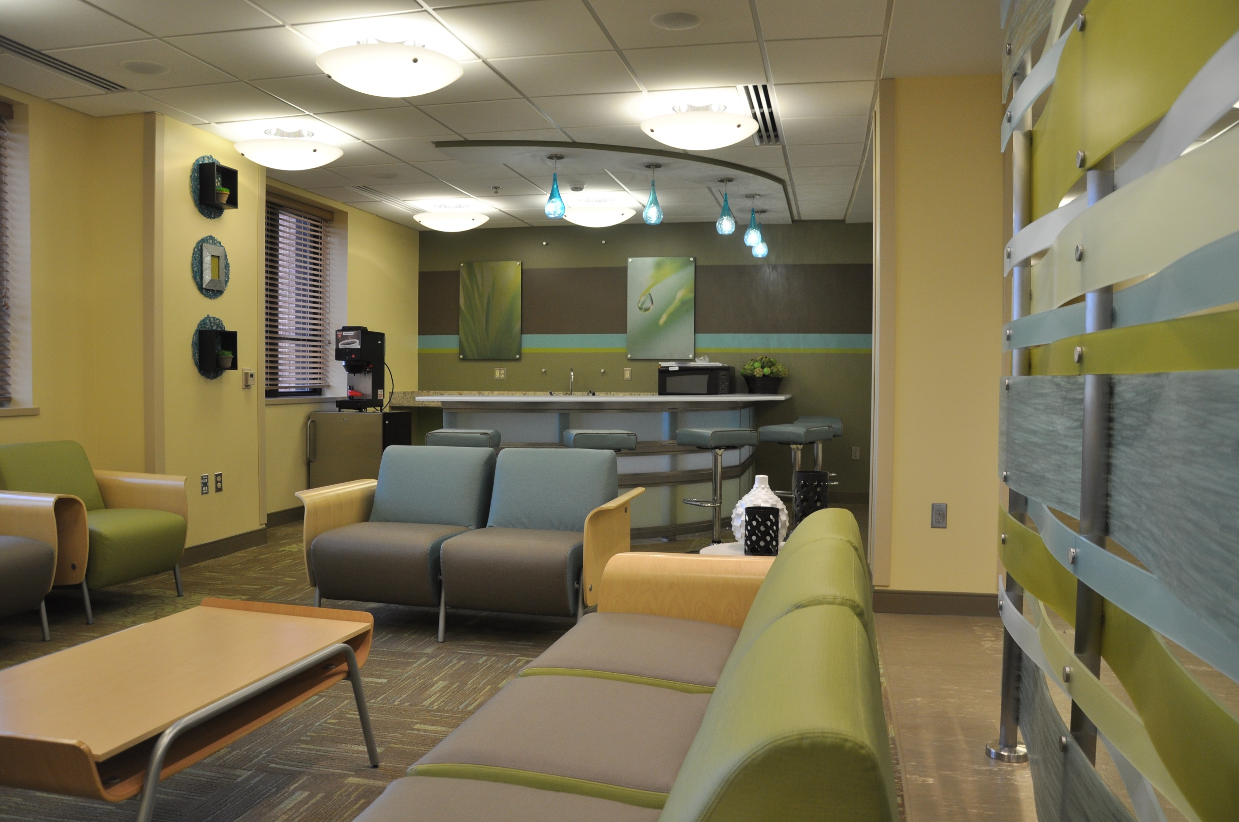

Slide 14
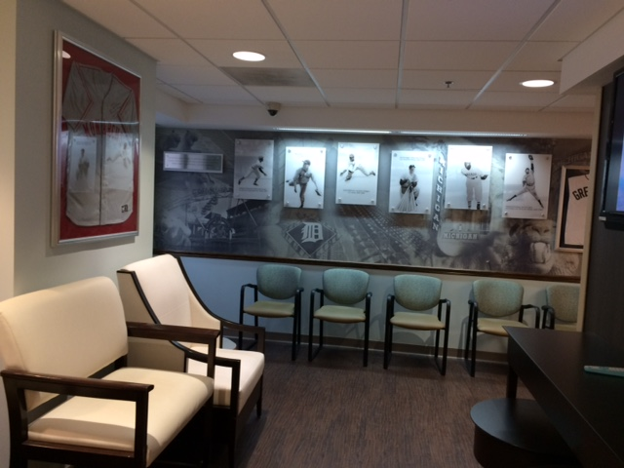

Slide 15
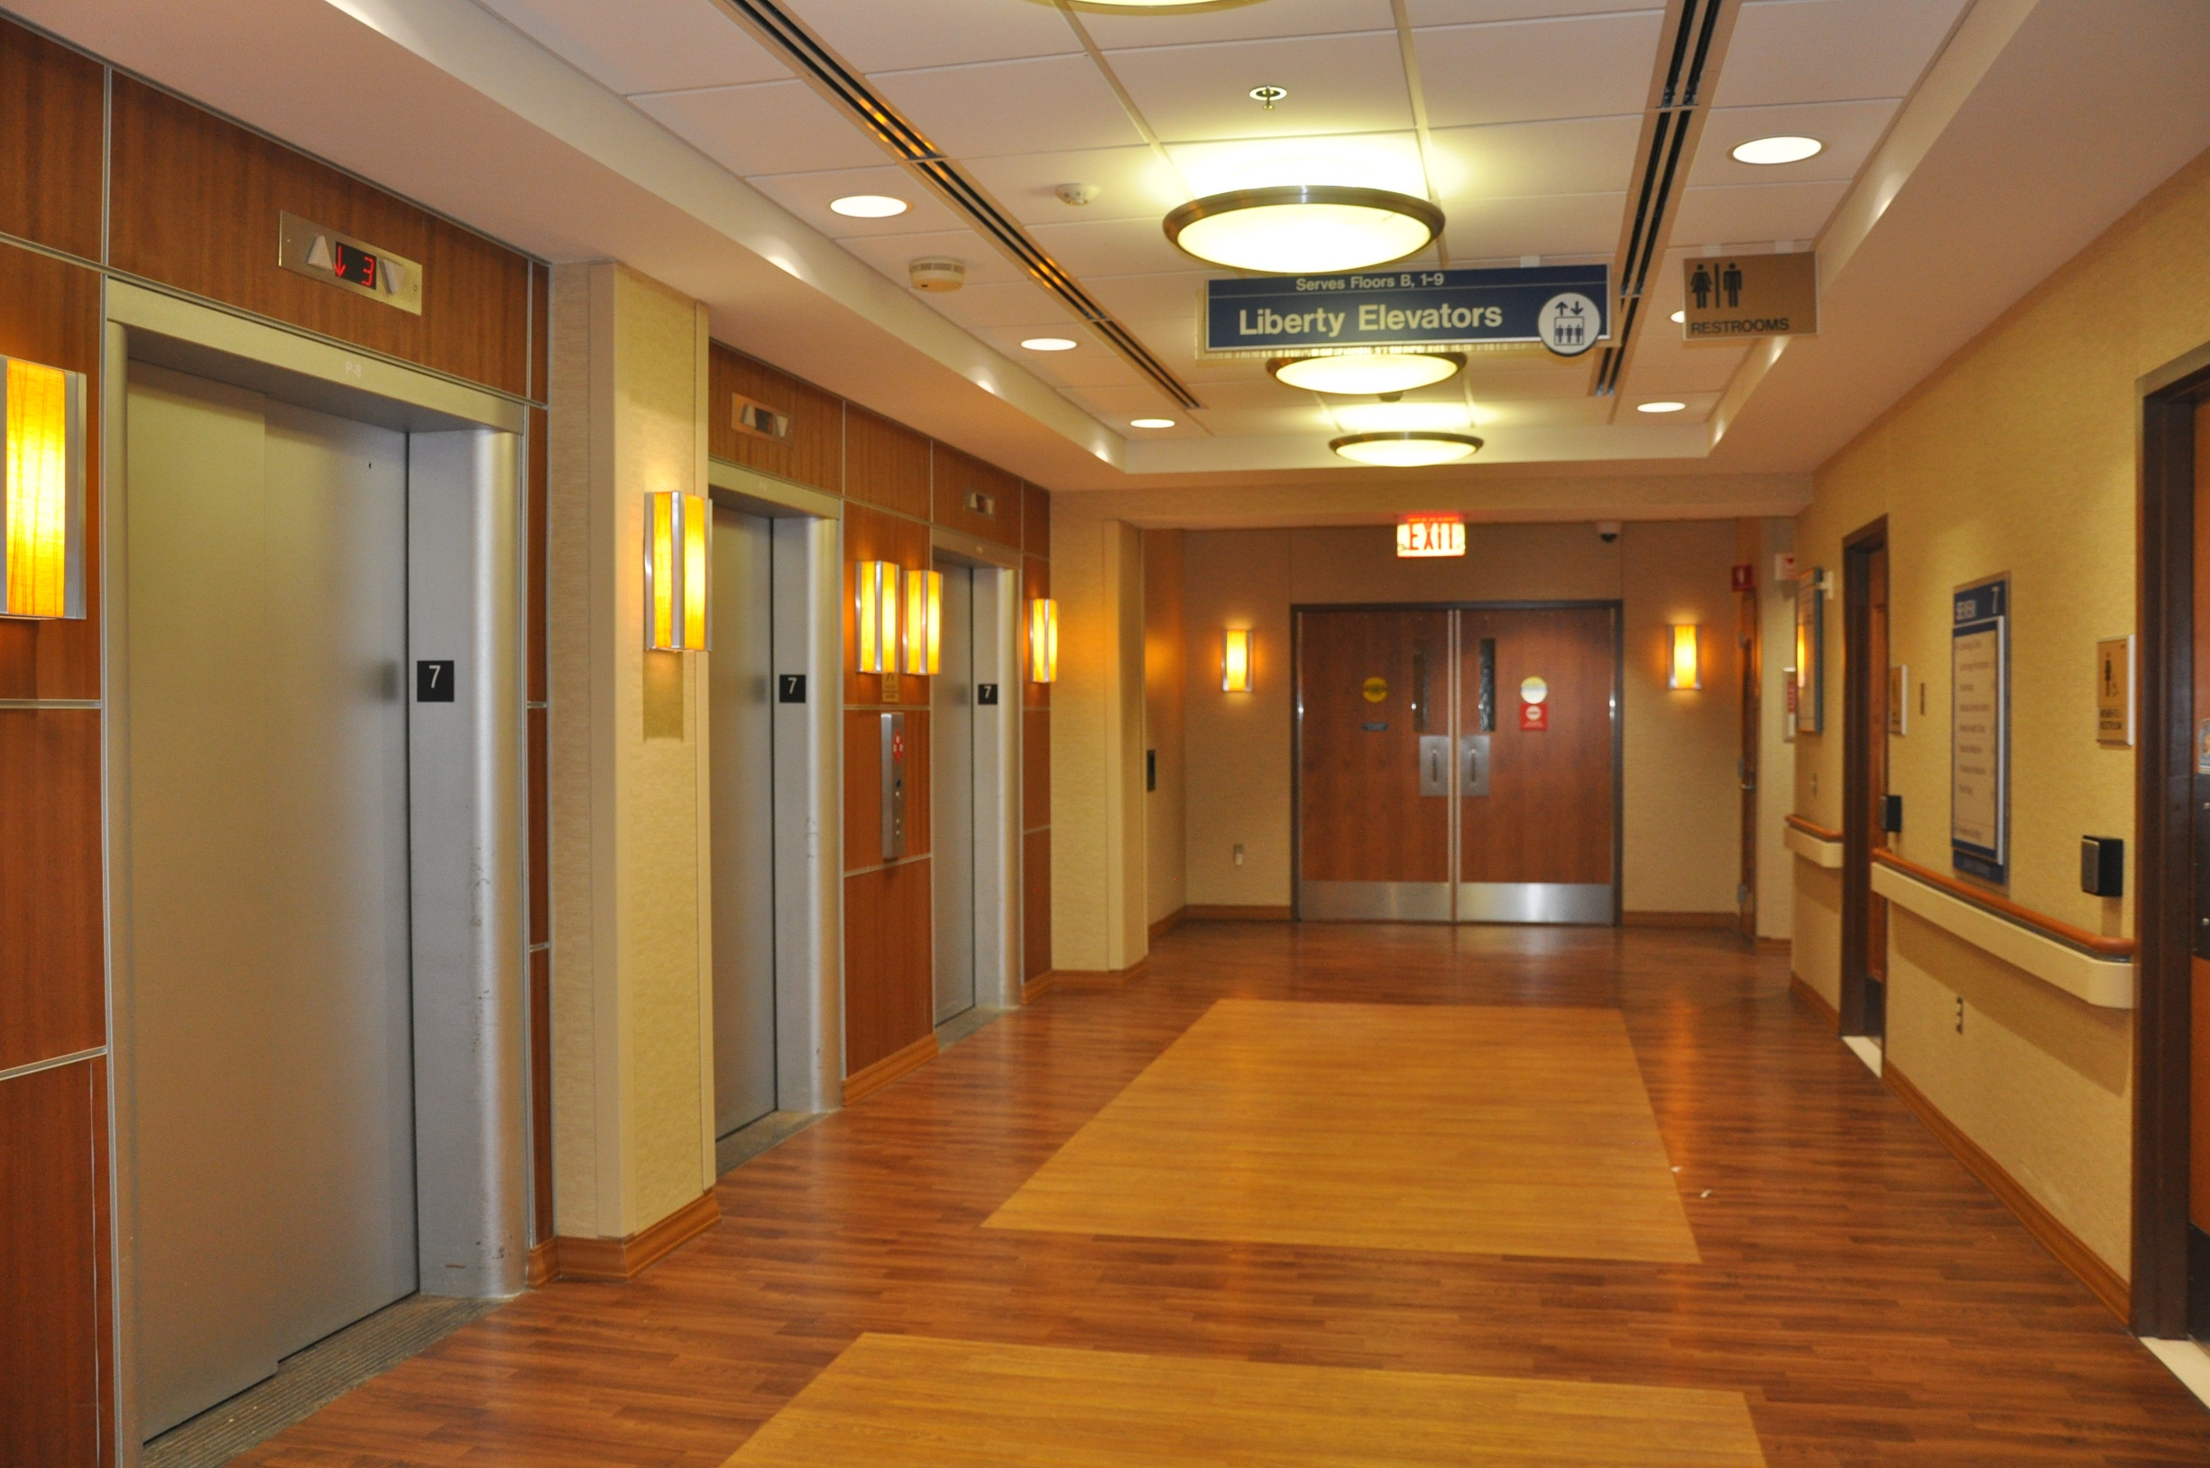

Slide 16
